Slide 1
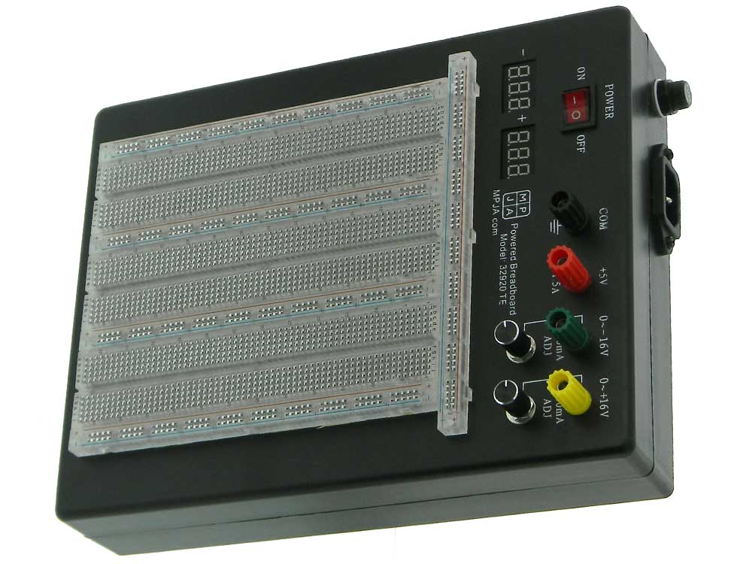
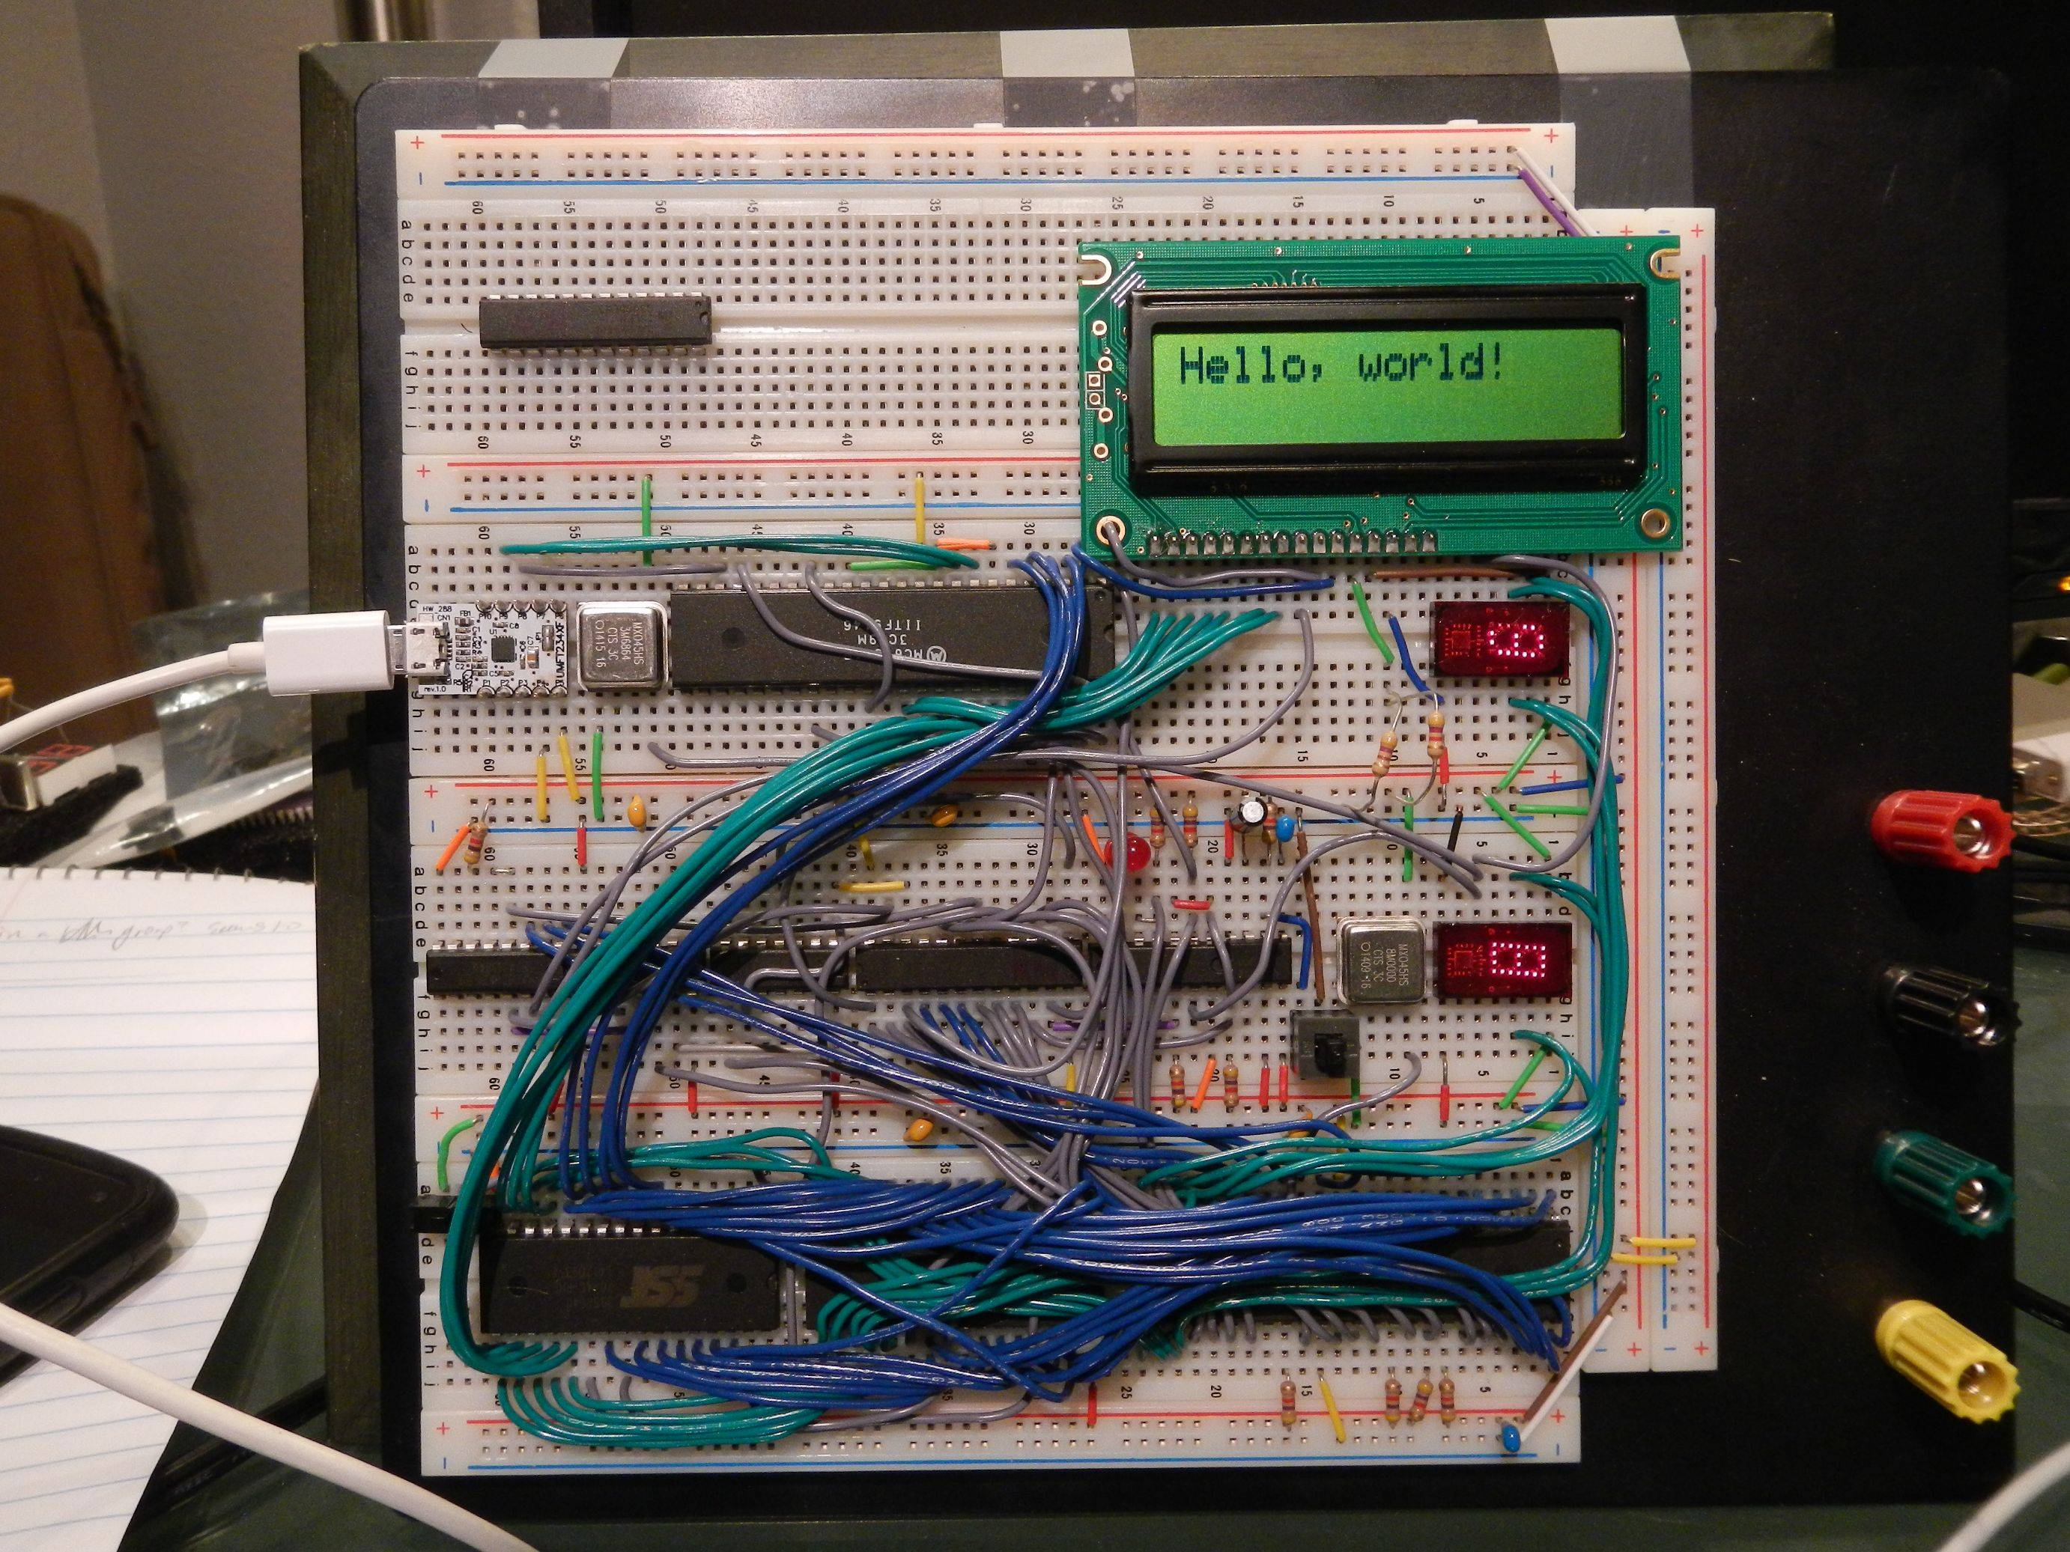
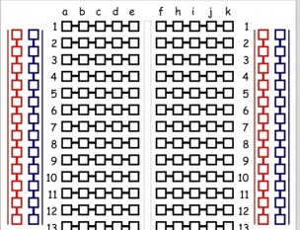
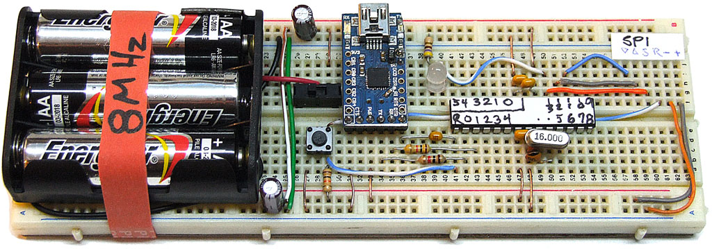
A3 – Electronics I
Solderless breadboard

Slide 2
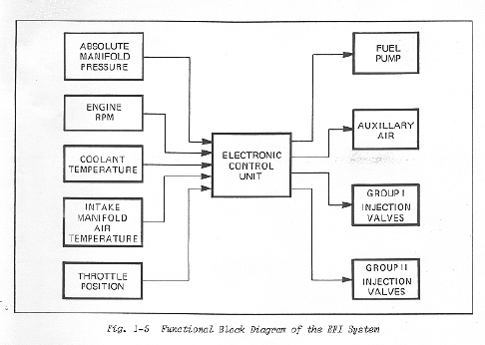
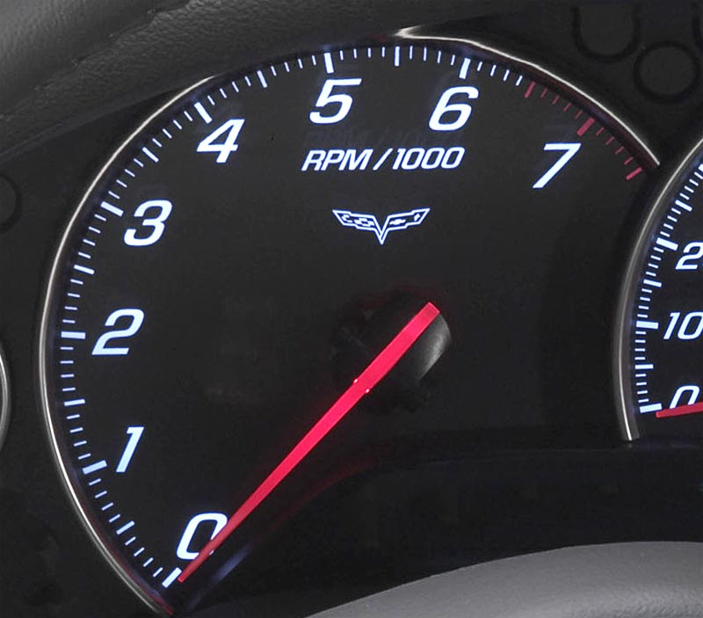
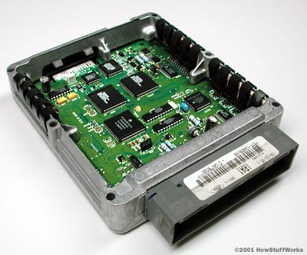
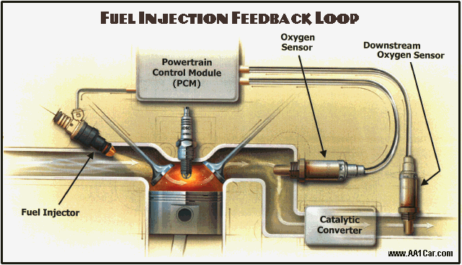
Automotive Electronic Control Unit (ECU)

Slide 3
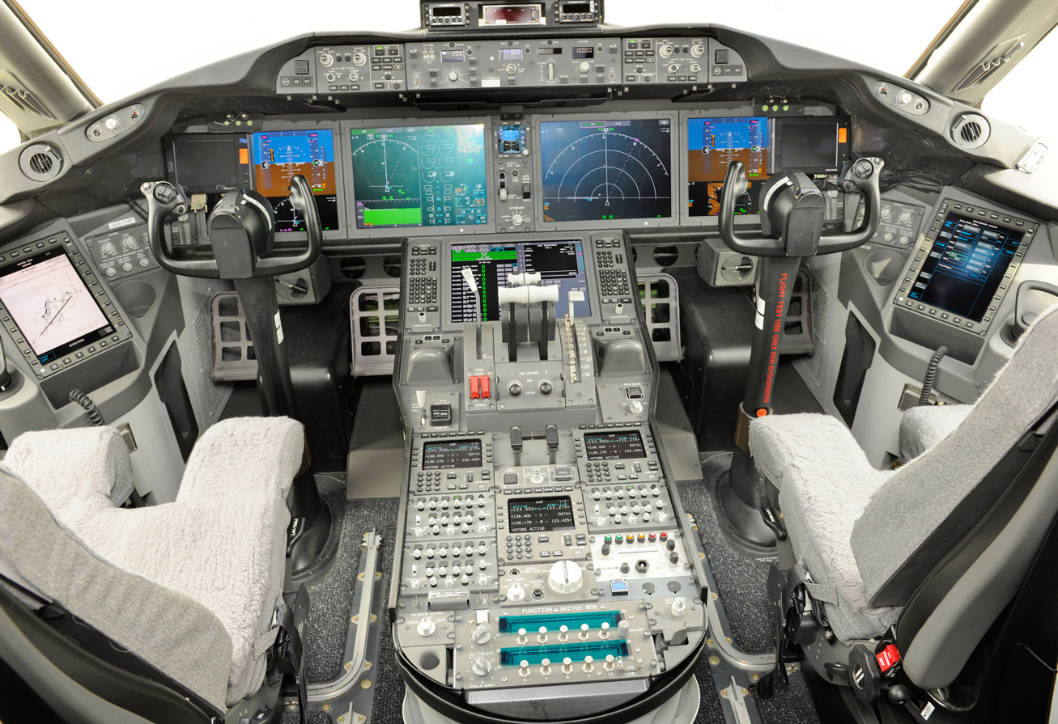
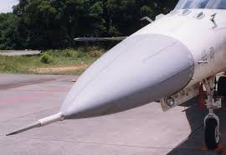
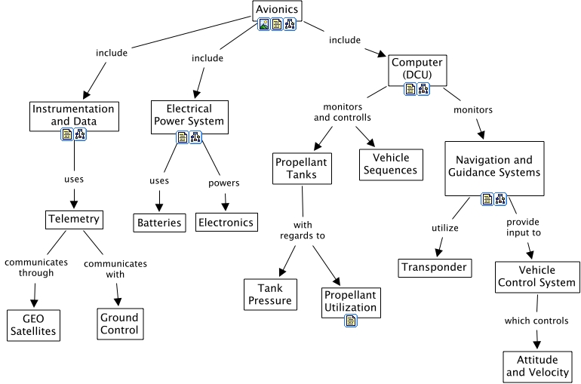
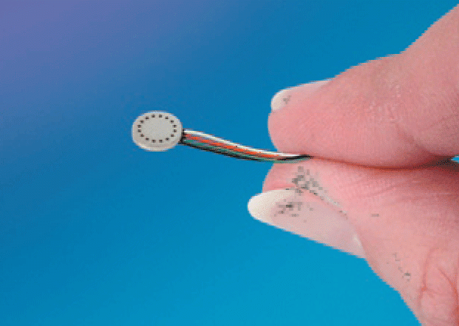
Avionics

Slide 4
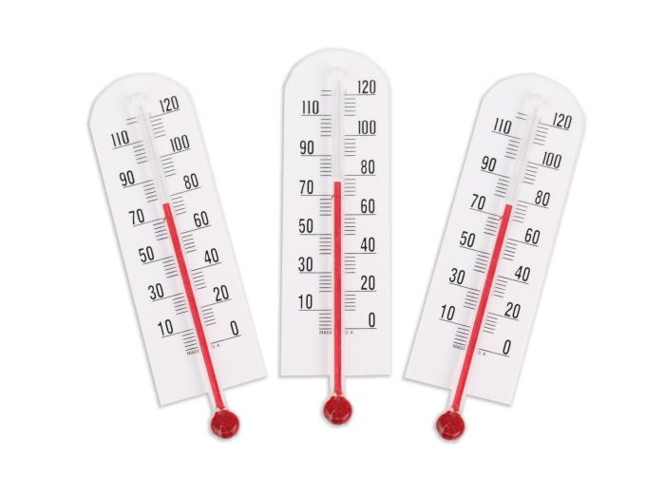
Transducer
Converts one physical stimulus to another.
Example: Alcohol thermometer
TEMPERATURE
LENGTH

Slide 5
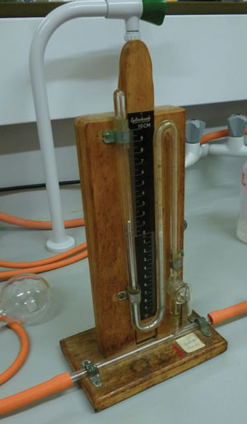
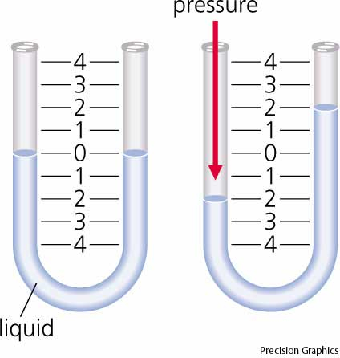
Manometer
Measures pressure

Slide 6
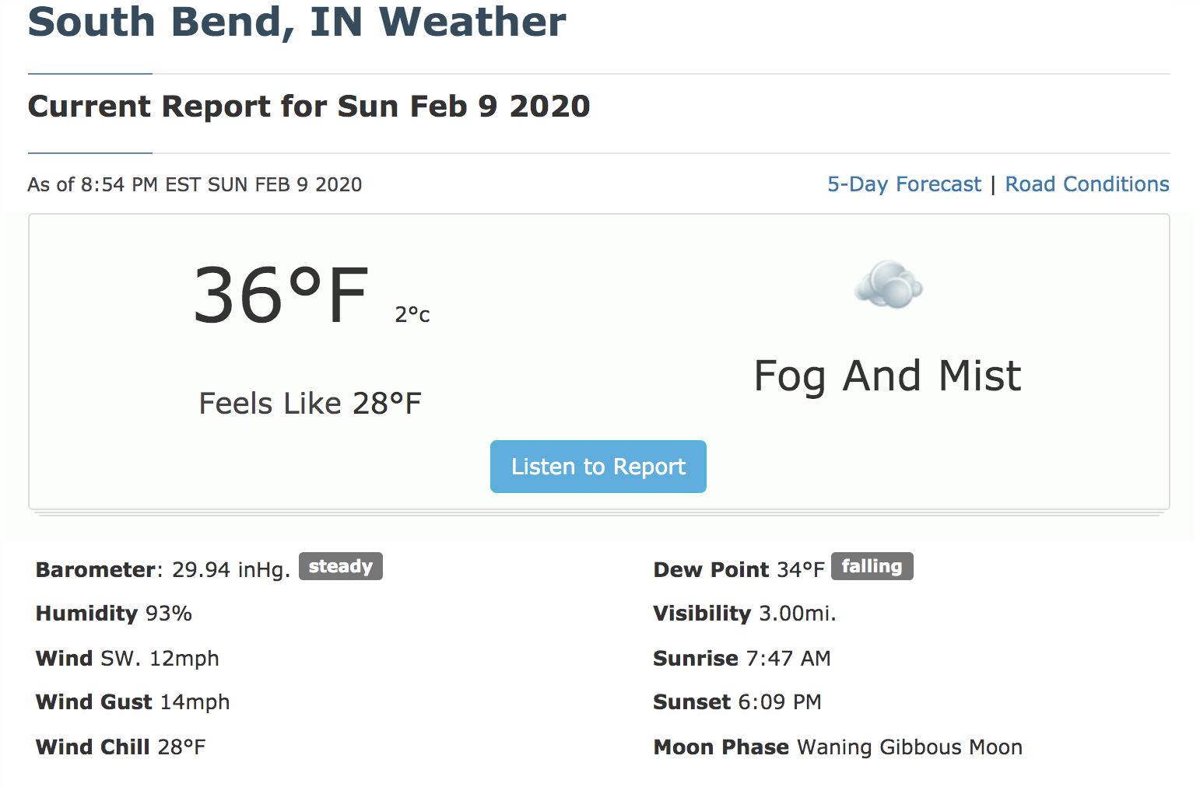

Slide 7
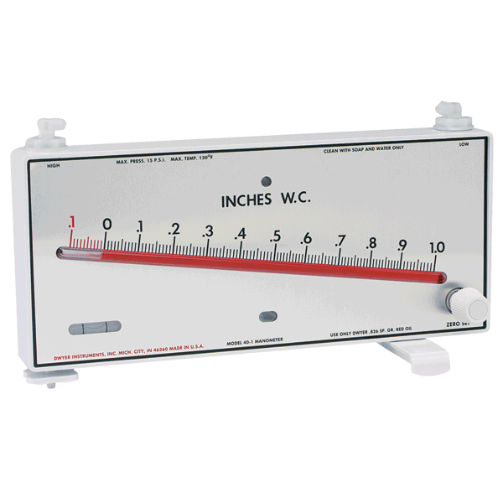
Sensitivity
U-tube Manometer
Less sensitive
Greater range
Inclined Manometer
More sensitive
Less range
http://www.dwyer-inst.com

Slide 8
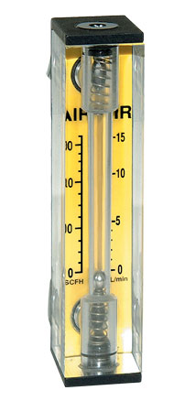
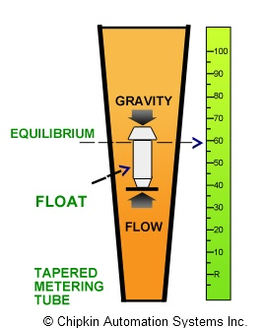
Rotameter
Measures flow rate.
Viscous drag causes a bead to levitate at a certain height.
Omega.com

Slide 9
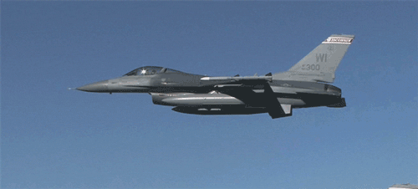
Electronic Transducers

Slide 10
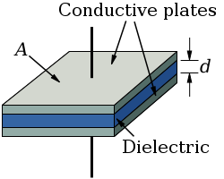
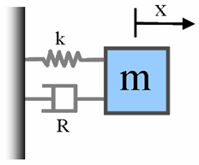
A4 - Capacitive Pressure Transducer
Pressure pushes capacitor plates closer together
Electrical capacitance:
h
h
Spring mass system
Hook’s law
Pressure
www.mathworks.com

Slide 11
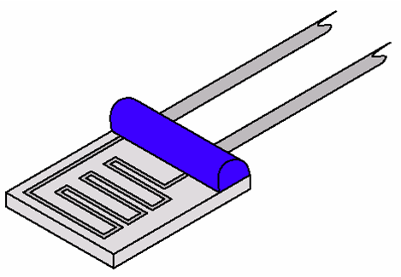
A4 - Calibration
RTD – Resistance Temperature Detector
The resistivity of a metal changes linearly with temperature.

Slide 12
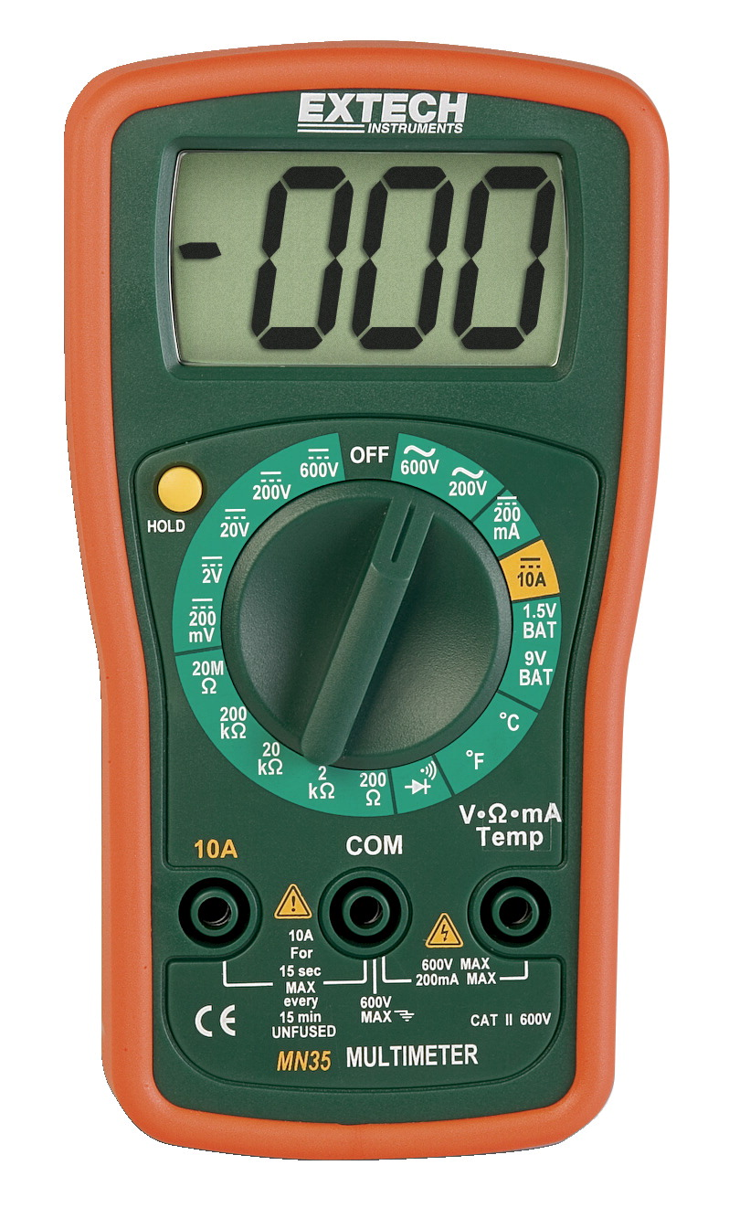
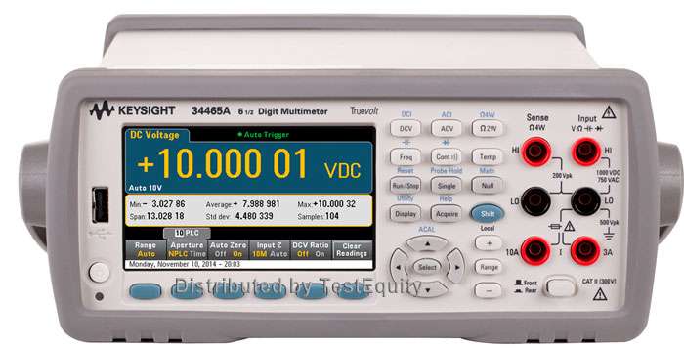
A4 – Sensor Calibration
Extech Handheld DMM
Keysight Precision DMM

